Slide 1
CUMMINS CAREER CONNECT
Connecting Ambitions to Careers: Your Pathway to Success Begins Here!"

Slide 2

Cummins Career Connect
Your Personalized Path to Success! Our comprehensive career website is designed to guide students in selecting the right college electives aligned with their future aspirations. Explore in-depth profiles of elective courses, each accompanied by detailed insights into related professions. Discover the skills and knowledge gained from each course, and learn how these subjects translate into rewarding career opportunities.Our interactive platform goes beyond traditional course descriptions offering real-world perspectives.
504 NIKITA AMBERAO-UCE2021504
514 KANAK DAULATANI-UCE2021514
Notes:
‹#›

Slide 3
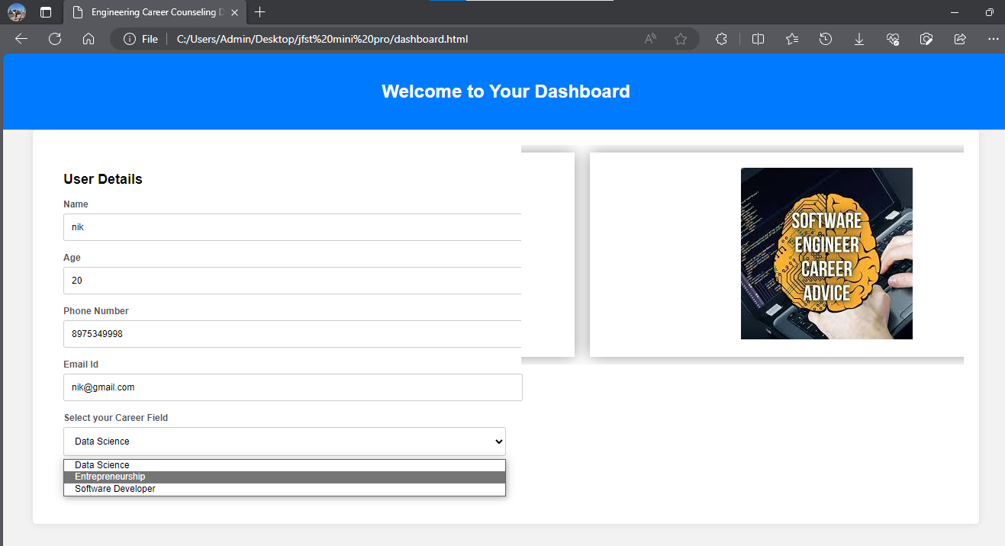
User Authentication
The login page of a career website enables registered users to access their accounts securely. Users provide their email address and password, which are verified against the stored credentials in the website's database.
The user registration page on a career website allows individuals to create an account by providing their personal information, such as name, phone no, and additional details like semester and year.
Notes:
‹#›

Slide 4
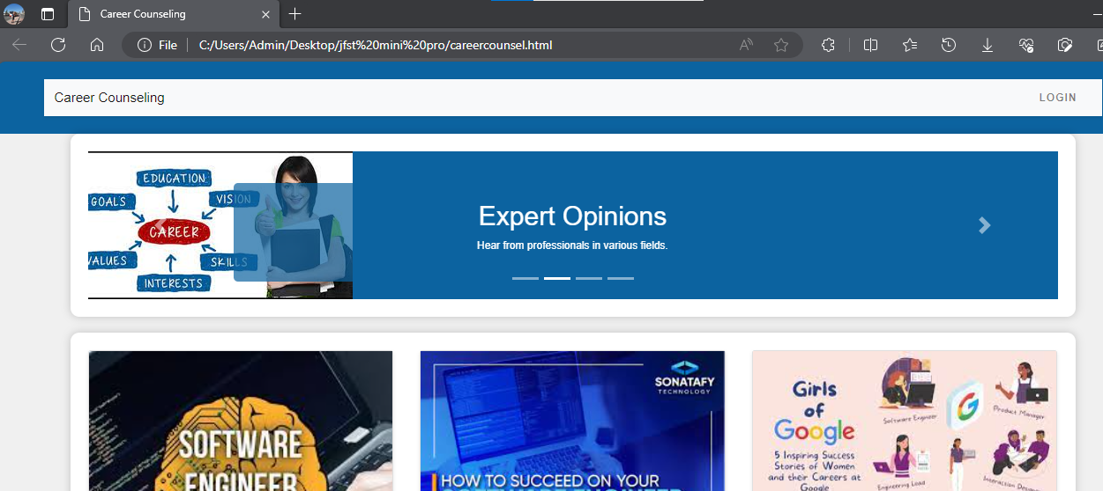
1
DASHBOARD
Notes:
‹#›

Slide 5
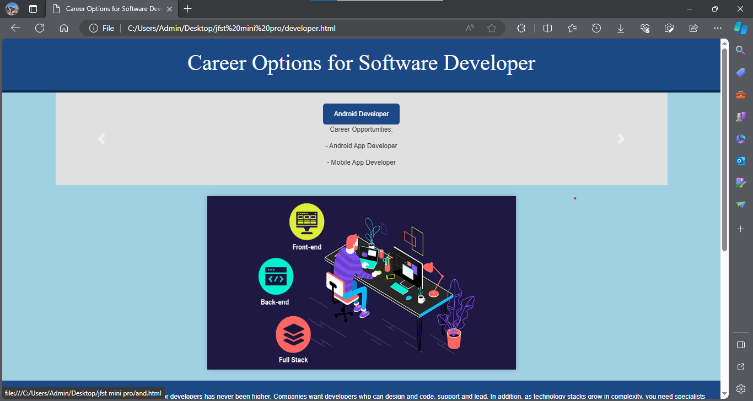
The Career Options page serves as a comprehensive hub on a career website, providing visitors with a diverse range of career paths. This page showcases various professions, industries, and roles . Users can explore different career options based on categories such as industry, or specific skills. Each career option typically includes detailed descriptions, and potential growth prospects. We have taken namely three major subject fields: a-Machine Learning and Data Science,Entrepreneurship and Software Development
Career Oriented Page
Notes:
‹#›

Slide 6
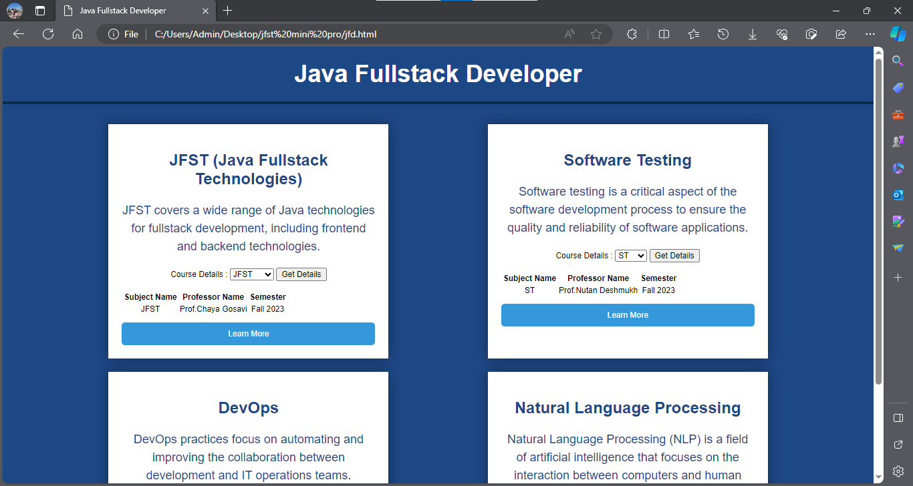
The Elective Courses page on an educational website showcases a curated selection of optional courses available to students within their academic program. Unlike core courses, electives provide students with the flexibility to tailor their education to their specific interests and career goals. This page provides detailed descriptions of elective courses, including course titles, brief summaries, learning objectives, and prerequisites. It often includes information about the faculty teaching the course and any unique projects or research opportunities associated with the elective.
Elective Oriented page
Notes:
‹#›

Slide 7
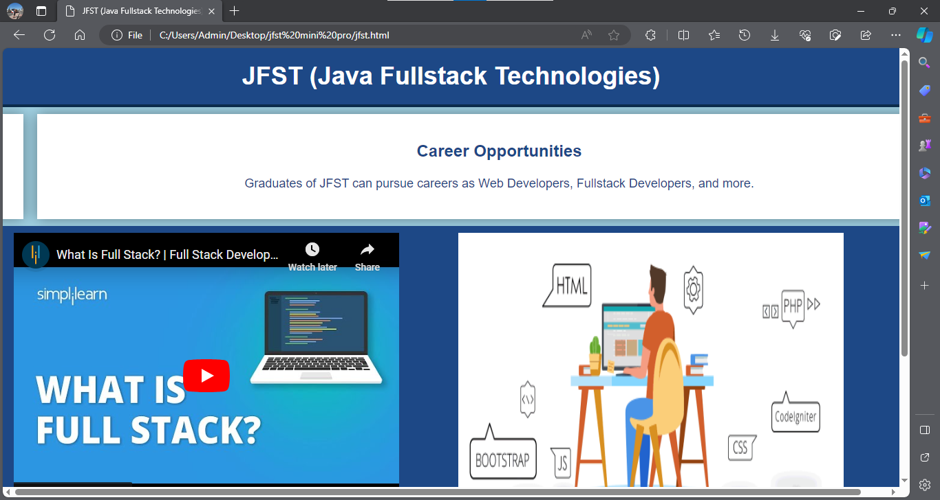
Subject
Orientation
Local Events
Notes:
‹#›

Slide 8

Technologies
HTML,CSS
JAVASCRIPT
AJAX
CAROUSEL,
BOOTSTRAP CAROUSEL
AJAX, web pages can fetch and send data to a server in the background, enabling dynamic content updates and improving the user experience by making web applications faster and more responsive. We have used it to fetch data regarding professors and subject alongwith semester.
HTML uses tags to define various parts of a web page, providing a hierarchical structure that web browsers use to render content.CSS is used to style our webpages.Javascript is used to implement functionality.
Bootstrap Carousel is a component provided by the Bootstrap framework, a popular front-end CSS framework. It is an implementation of a carousel that comes with pre-designed styles and features.
Notes:
‹#›

Slide 9

THANK YOU!

